Slide 1
FGT integrate with Telcom Cloud
Liu Gang

Slide 2



Architecture-1
The same az ha
internet
Two FGT in the same az1
Build HA
Vm traffic will route fgt-1 primary
Fgt1 snat and dnat the server traffic
Enable multi EIP bind fortigate port1 map virtual ip
AZ1
fgt-1
fgt-2
vm-1
vm-2
This Architecture is ready with fortigate , HA in the same AZ , and support multi floating ip bind port1
means every application with unique EIP

Slide 3
Architecture-2
The different az ha
internet
Two FGT in the different az1
Build HA
Vm traffic will route fgt-1 primary
Fgt1 snat and dnat the server traffic
Enable multi EIP bind fortigate port1 map virtual ip
AZ1
AZ2
fgt-1
fgt-2
vm-1
vm-2

Slide 4

Architecture-3
The dual LB with fortigate
internet
AZ2
Two FGT in the different az1
Build HA with ELB and ILB (AA/AS)
Vm traffic will route ILB floating ip
Fgt1 snat and dnat the server traffic
FGT port1 will bind ELB public floating ip
AZ1
External LB
fgt-1
fgt-2
Internal LB
vm-1
vm-2

Slide 5
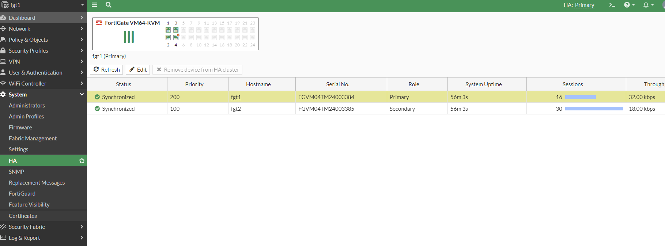
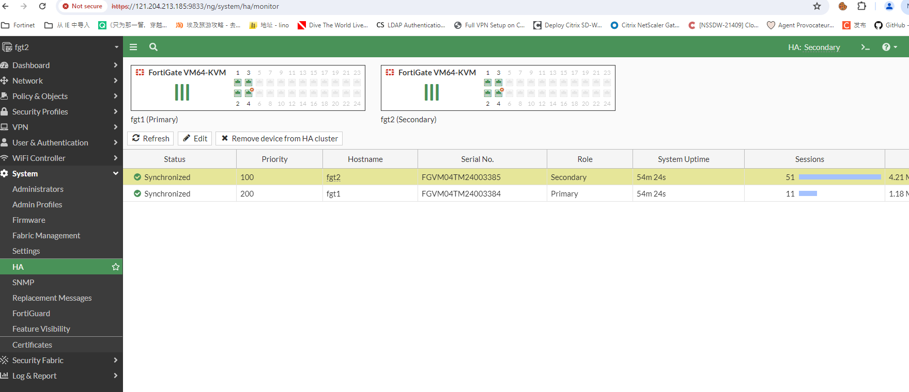
Case-1
The same AZ HA Done

Slide 6
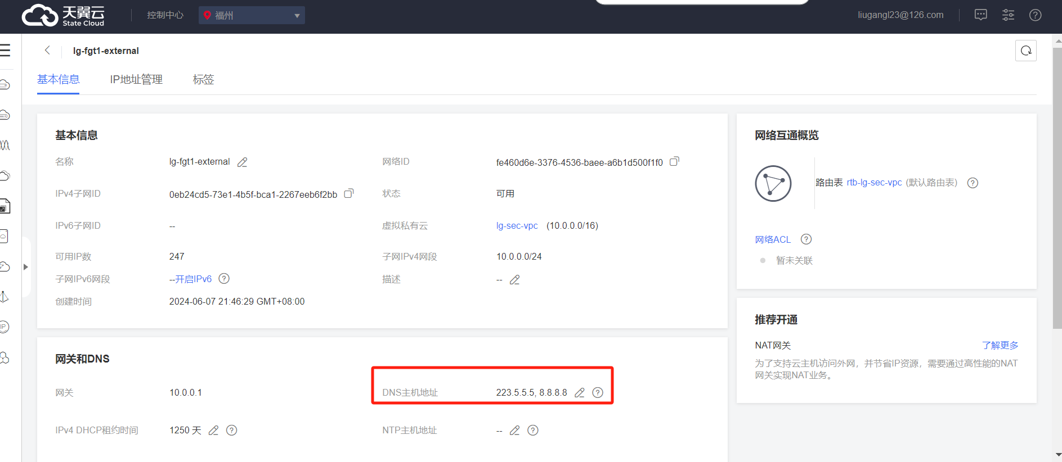
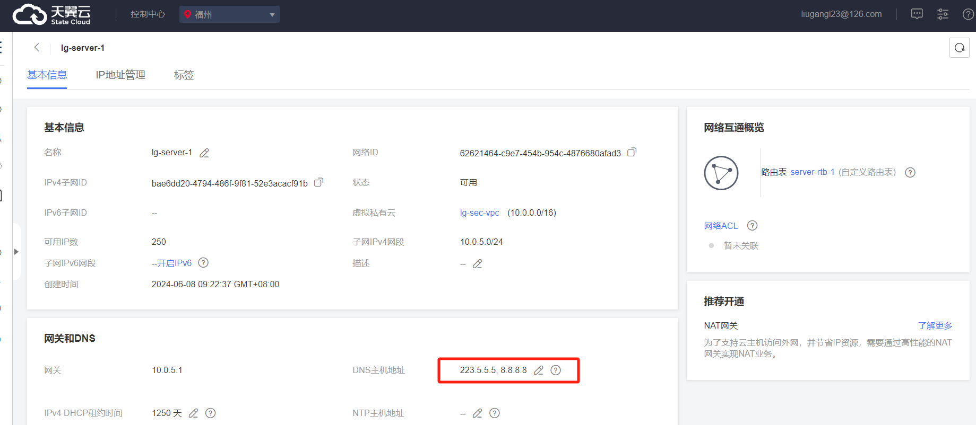
Case-1
Subnet dns config
Cautions: need to set dns to subnet by yourself which every want to resolve dns subnet.

Slide 7
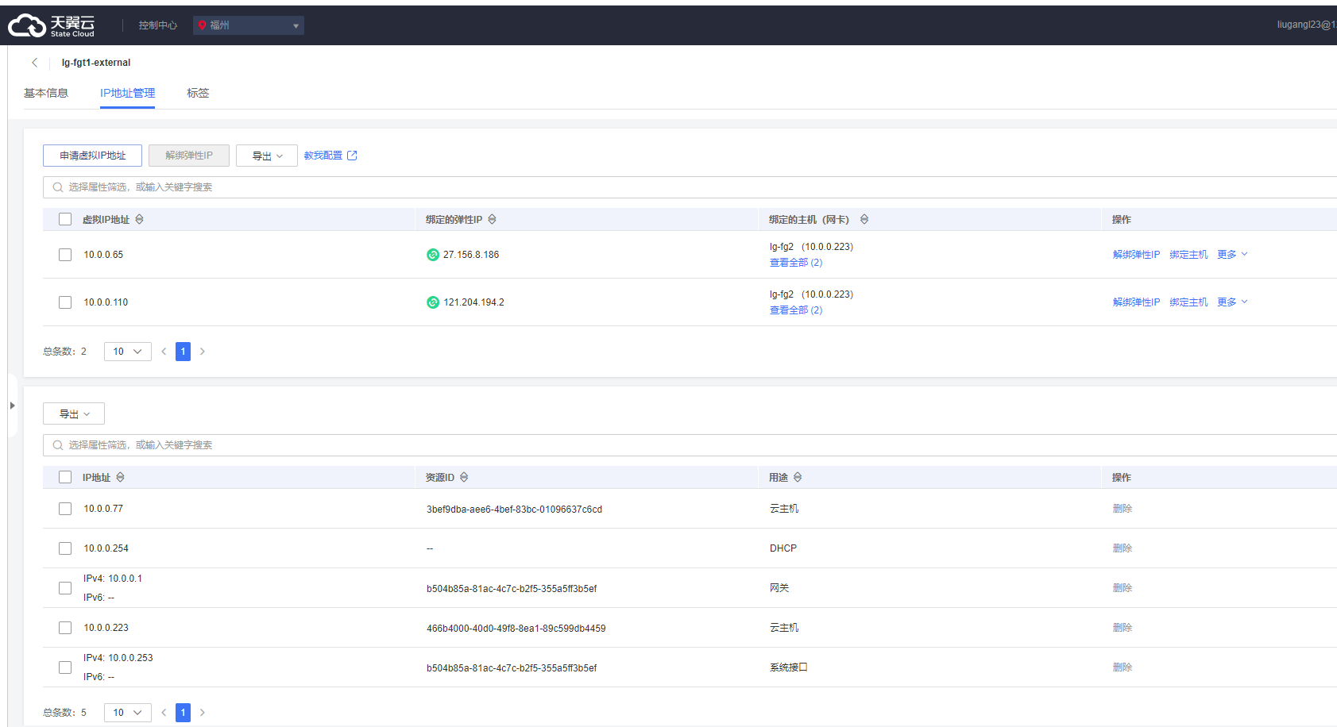
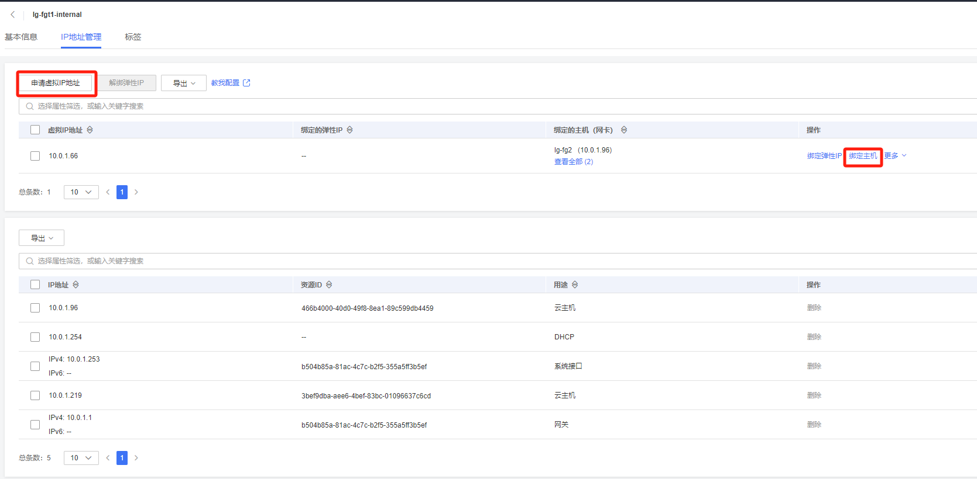
Case-1
Virtual ip

Slide 8
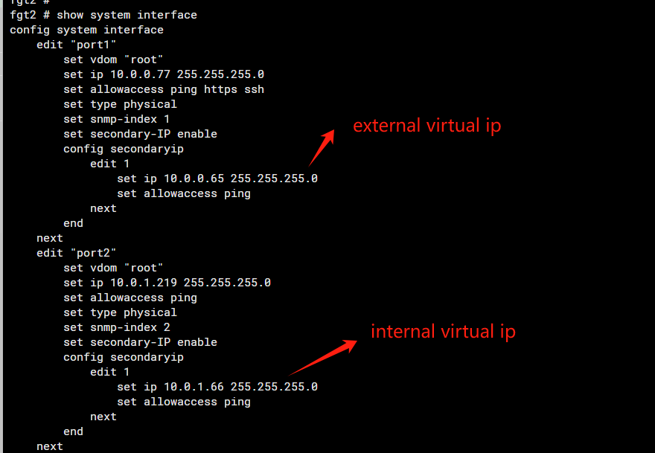
Case-1
Fgt config

Slide 9
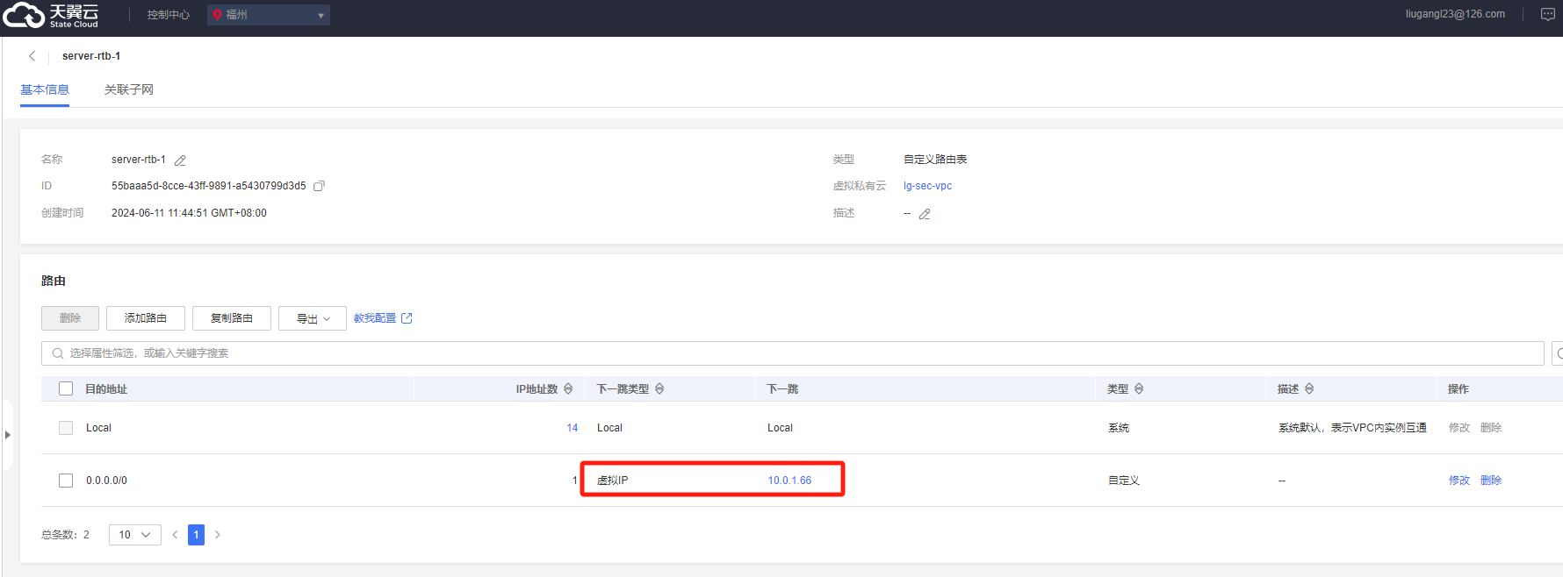
Case-1
Route table

Slide 10
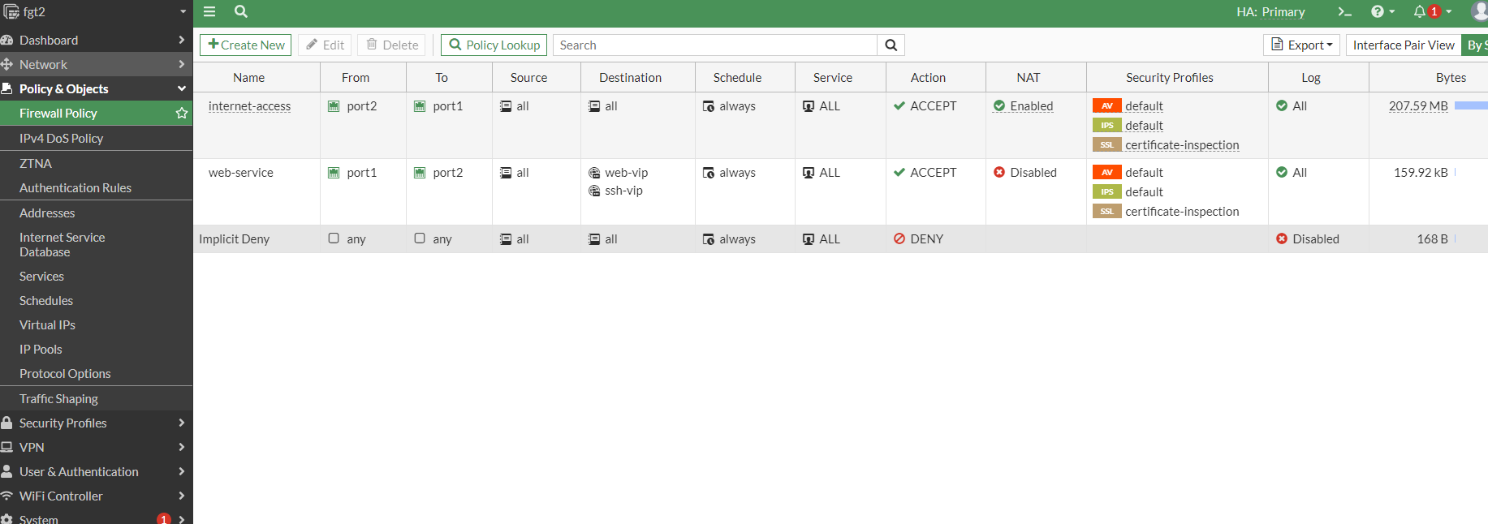
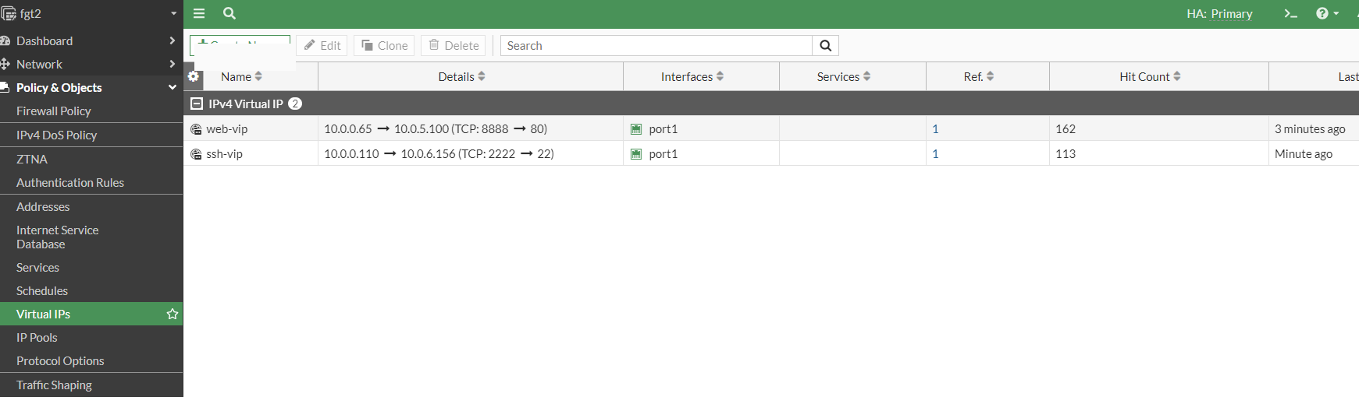
Case-1
Firewall policy

Slide 11
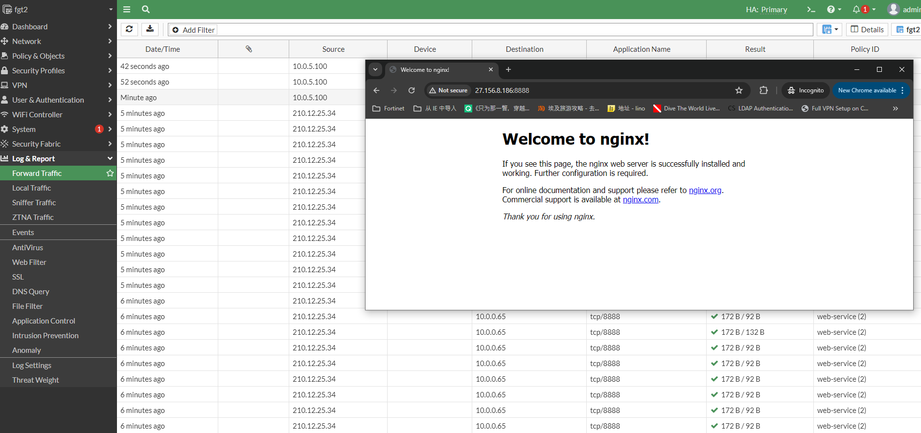
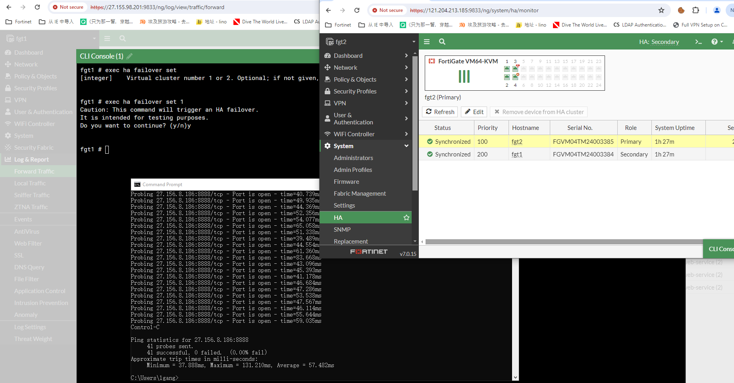
Case-1
Verify ha failover

Slide 12
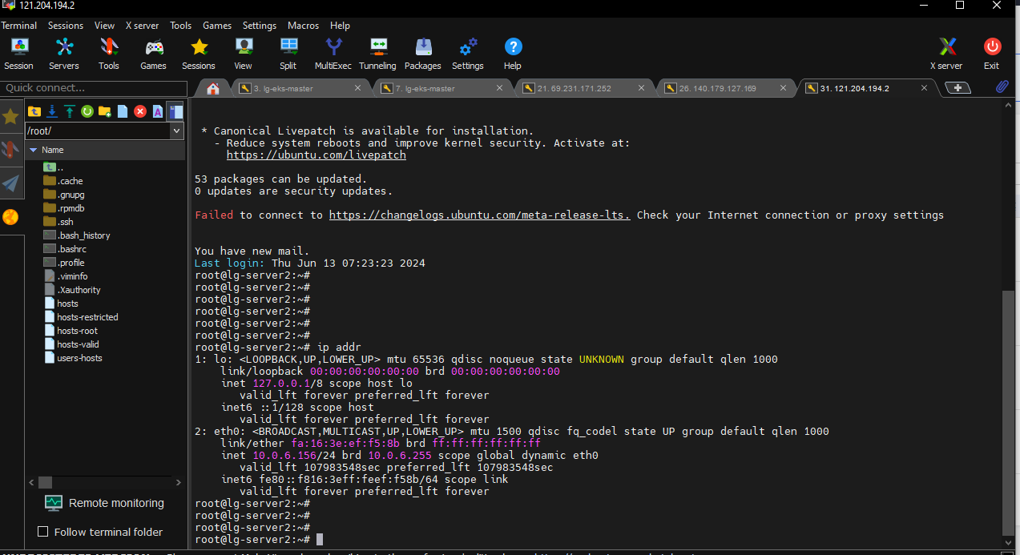
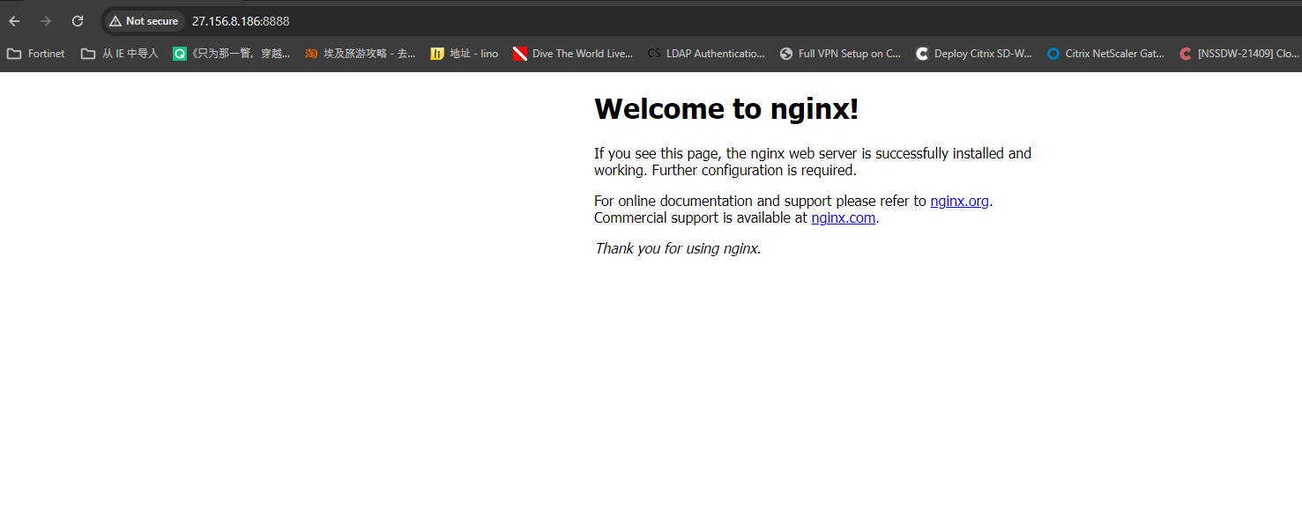
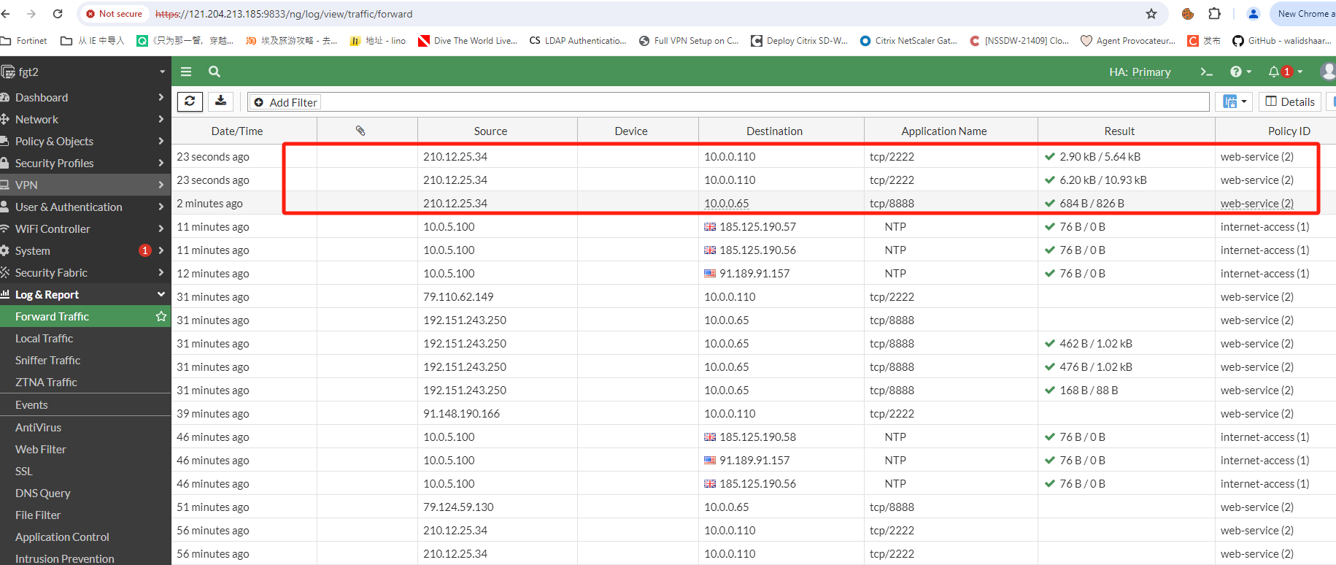
Case-1
Verify north traffic

Slide 13
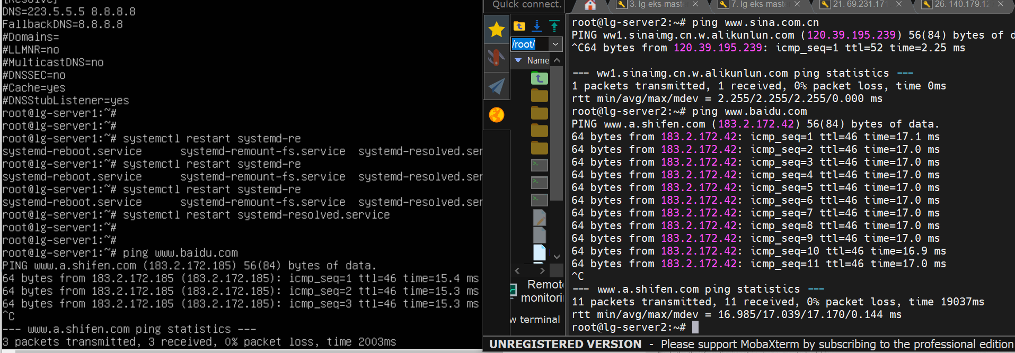
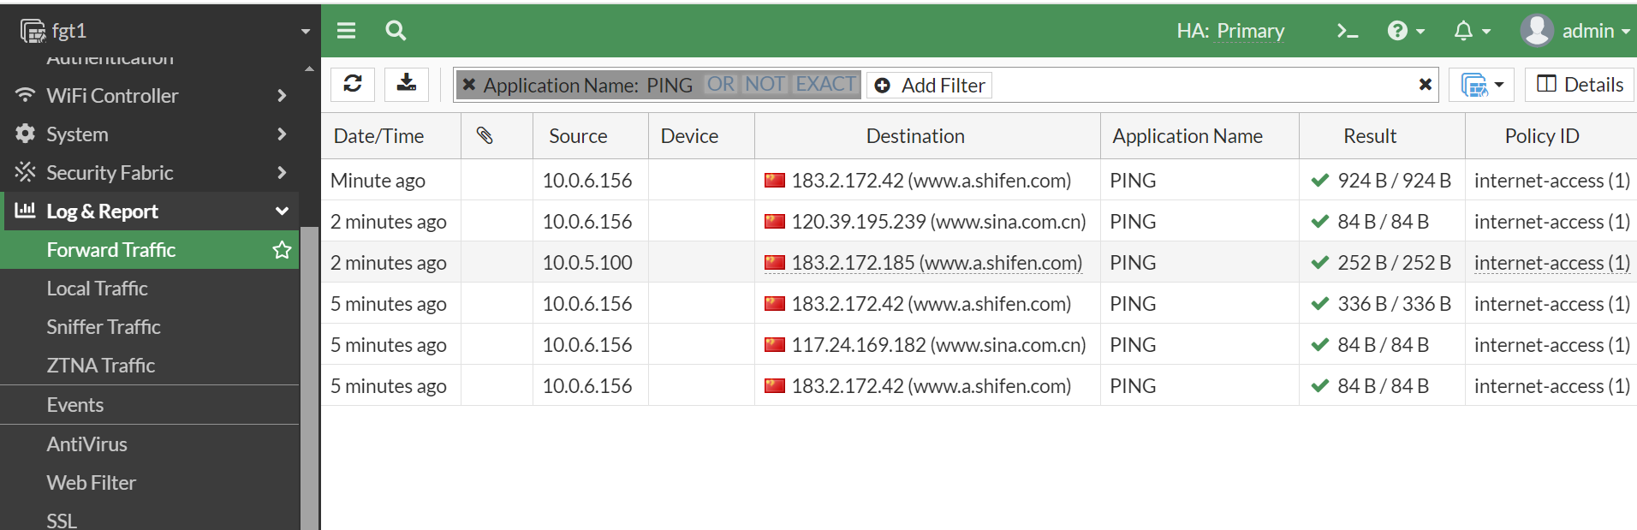
Case-1
Verify south traffic

Slide 14
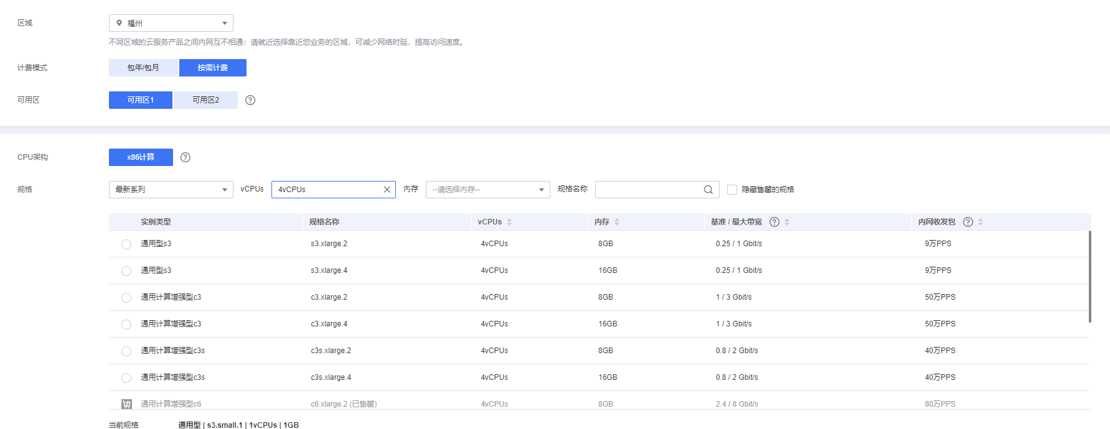
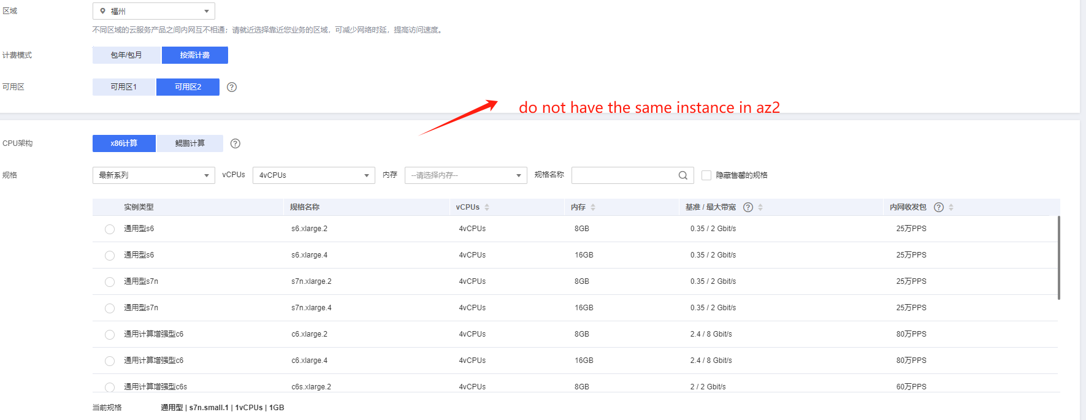
ISSUE-1
The same region , have much difference resource in two AZ.
It means we do not use the same instance for Fortinet product.

Slide 15
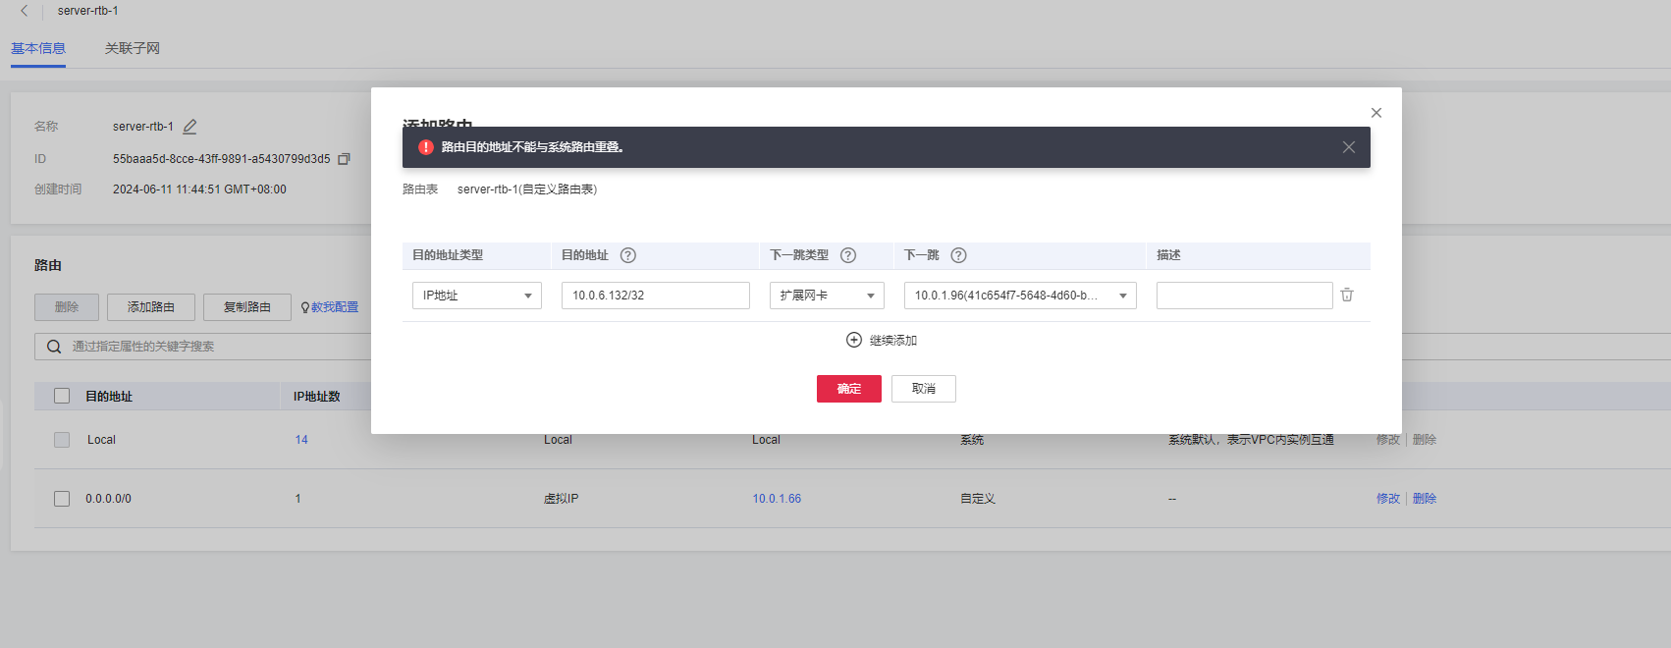
ISSUE-2
Not support detail route in route table , east-west traffic control not use in the same vpc

Slide 16
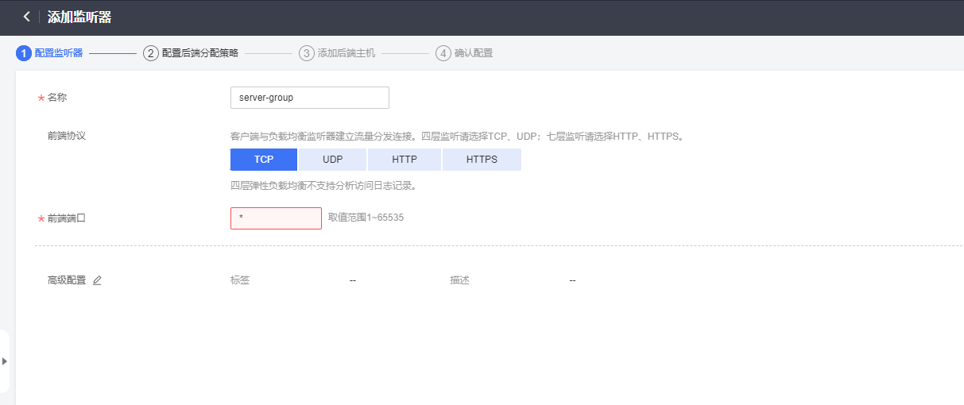
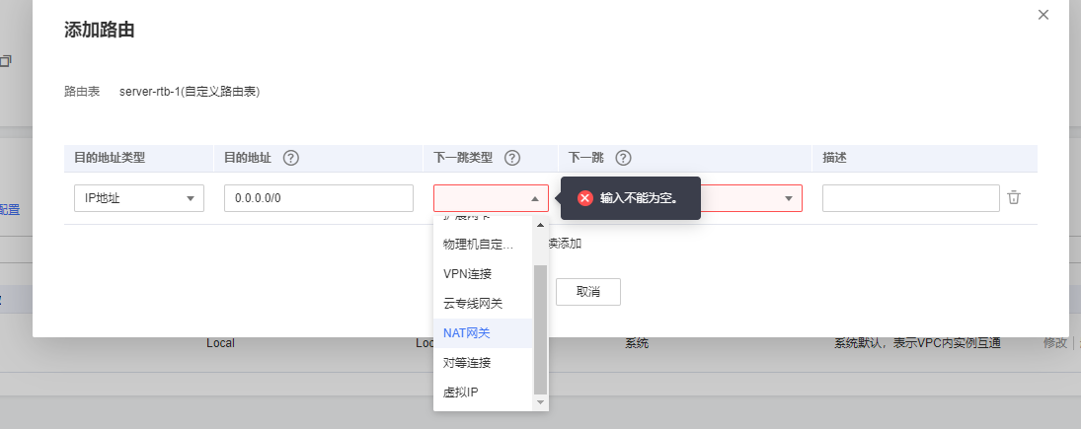
ISSUE-3
Not support route next-hop to lb floating ip
There are not have load balance optional . It means we could not use sandwich mode , support ELB-FGT-ILB architecture .

Slide 17
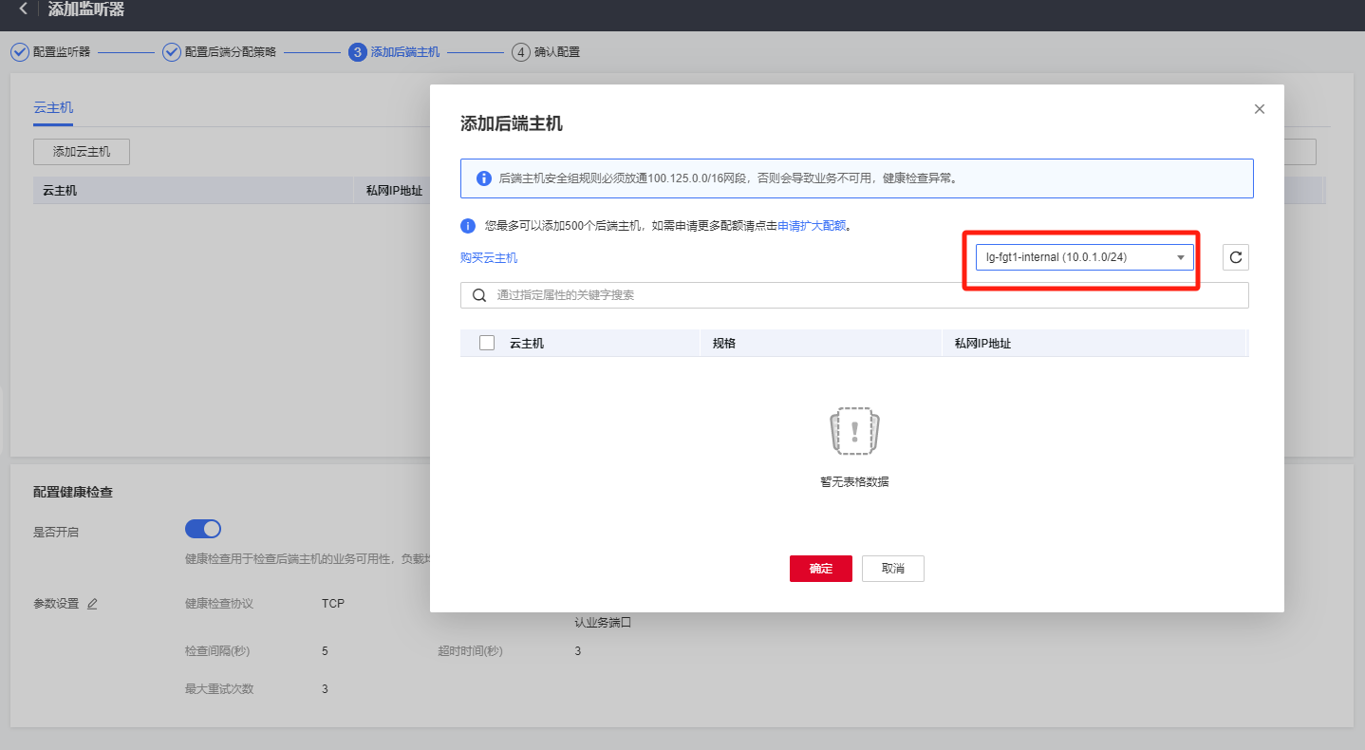
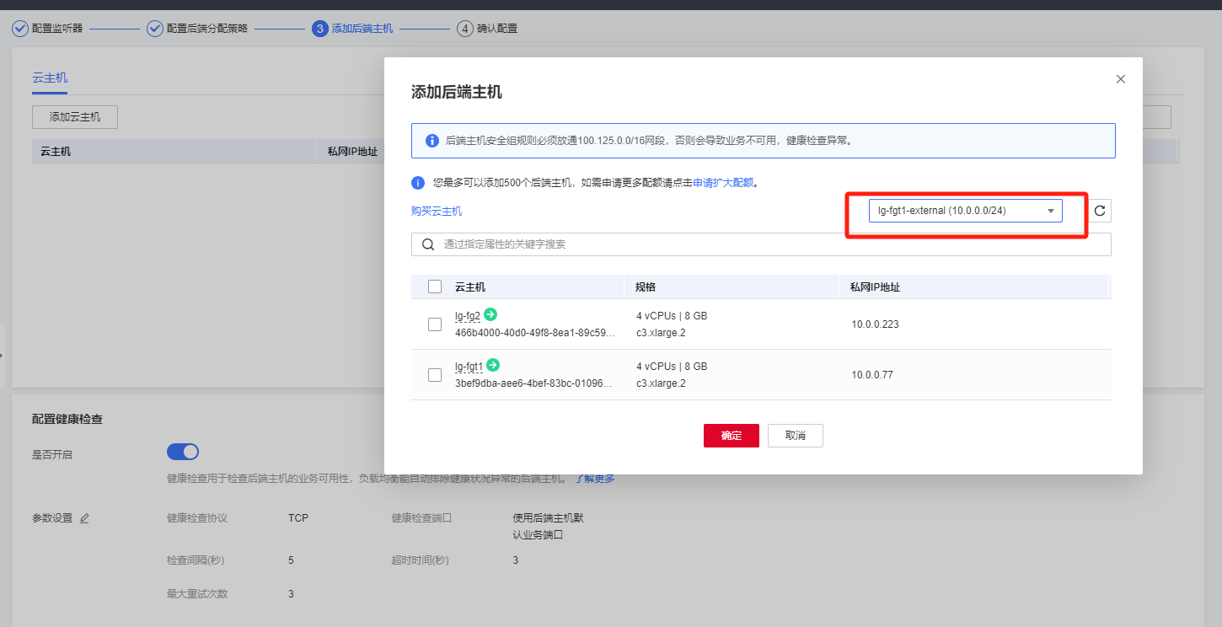
ISSUE-3
Not support route next-hop to lb floating ip
It could not discover by fortigate inside interface port2 , just use primary interface port1.

Slide 18
Thank You ☺

